Slide 1
Python

Slide 2
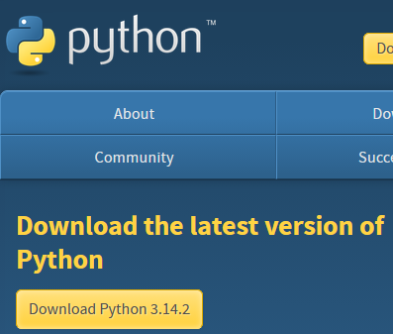

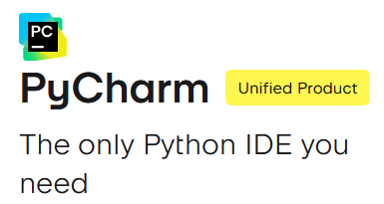
Required Software
Python
PyCharm
VSCode

Slide 3
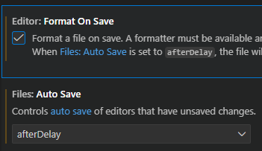
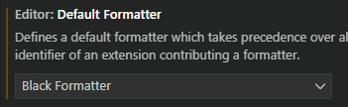
VSCode Settings/Plugins
Python + Pylance - language support
Jupyter - visualization
Black Formatter - follow consistent standard
Isort - organize imports
flake8/pylint/ruff - linting
Python test explorer - unit test support
Live Share - collaborative editing

Slide 4
What is Python?
Interpreted language - code is executed line by line, no compilation step needed
High-level language - abstracts away low-level memory management, hardware details, garbage collection
Dynamically typed - variables do not require type declarations
Cross-platform - runs on windows, macOS, linux
Object-oriented - supports classes, objects, inheritance, etc.

Slide 5
Under the Hood
Python code (.py files) are compiled into bytecode (NOT machine code) by CPython
The bytecode is then interpreted and executed by the Python Virtual Machine (PVM) inside CPython

Slide 6

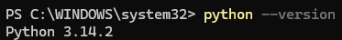
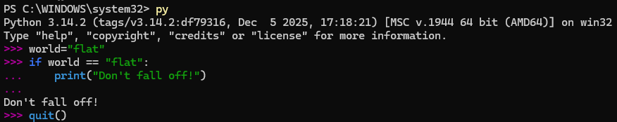
Python Environments, py, & Interactive Mode
Recommended to use powershell!

Slide 7
venv
Create a virtual environment for our python app:
Make sure to activate, and then check for pip updates:
Some may need to allow scripts to run these commands:

Slide 8
pip & Jupyter setup
We install packages with pip (‘pip installs packages):
Packages may also be installed via text file on each new line:
Here we connect our venv to serve as the kernel for jupyter:

Slide 9
Challenge
Goal:
Create a Jupyter notebook for learning
Details: ~10 min
Create a project folder and initialize it as a git repo
Initialize a venv inside the project folder
Install the following packages to the venv: jupyter, ipykernel, numpy, pandas, matplotlib
Associate the venv with jupyter and launch your notebook

Slide 10
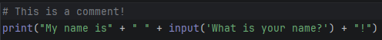
Strings, Print, Input, & Comments
Strings are valid with both single and double quotes
We can start a new line with the escape character ‘\’ + ‘n’

Slide 11
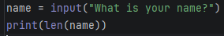
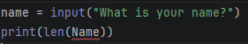
Variables & len()
Variables are dynamically typed:
Python is case-sensitive:

Slide 12
More on variables & Case Conventions
Must start with a letter or underscore character
Only alphanumeric symbols and underscores are valid: (A-z, 0-9, and _ )
Camel Case (rarely used convention in Python):
myVariable = ‘John’
Pascal Case (used for Python class names):
MyVariable = ‘John’
Snake Case (most common in Python; used for almost everything not a class):
my_variable_name = ‘John’
Kebab Case (never or rarely used in python)
My-variable-name = ‘John’

Slide 13
Variables Continued
We can assign multiple variables at once
We can also assign them the same value

Slide 14
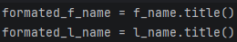
Challenge
Goal:
Ask a user for their info and print it
Tip: Use the title() method to format names:
Details: ~10 min
Ask the user for their full name, birthday, & email
Store the data in variables
Print the information back to the console, on a new line for each item

Slide 15
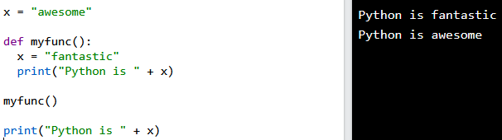
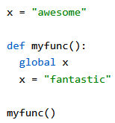
Functions & Variable Scope
Functions are defined with the ‘def’ keyword
Variables outside of functions have Global scope
Variables inside functions have Local scope, unless the global keyword is used

Slide 16
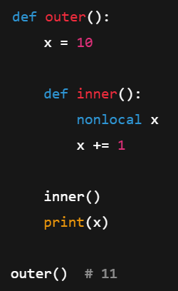
Built-In Scope & Enclosing (nonlocal) Scope
Built-In Scope
OOB methods/keywords provided by Python:
len()
print()
str()
Enclosing Scope
Inner functions have access
Can’t override unless we use nonlocal keyword

Slide 17
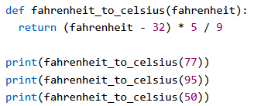
Functions take in and return data

Slide 18
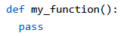
Creating Placeholder Functions
Functions can’t be empty, but we can create placeholder functions using the ‘pass’ keyword!

Slide 19
Challenge
Goal:
Refactor previous challenge
Details: ~10 min
In a function:
Ask the user for their full name, birthday, & email
Store the data in variables
Print the information back to the console, on a new line for each item

Slide 20
More on naming conventions…
Item | Convention | Example
Variable | snake_case | user_name
Function | snake_case | get_user()
Constant | UPPER_SNAKE_CASE | MAX_SIZE
Class | PascalCase | UserService
Method | snake_case | save()
Attribute | snake_case | created_at
Protected | _snake_case | _cache
Private | __snake_case | __state
Module | snake_case.py | email_utils.py
Package | snake_case/ | data_access/

Slide 21
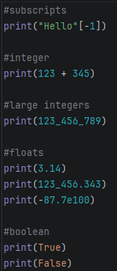
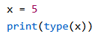
Data Types
str = string
int = integer
float = decimals
bool = boolean true/false
None = NoneType
(These are examples of Primitive data types, there are many more)

Slide 22
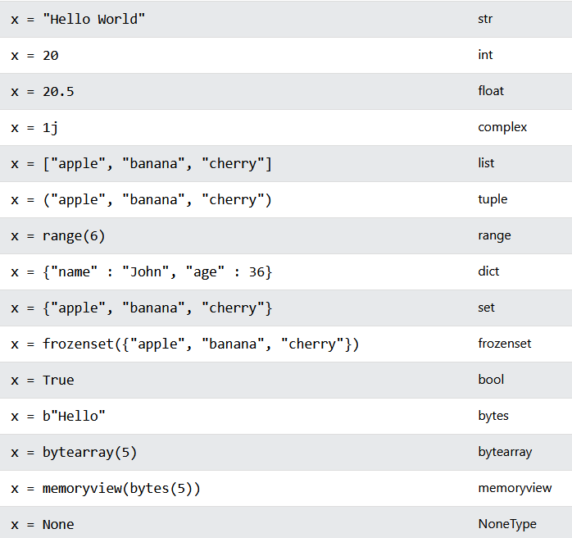
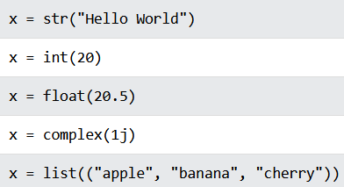
Setting Each Type
You can also use constructor functions to define the type explicitly:

Slide 23
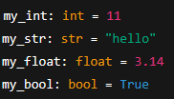
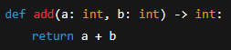
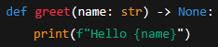
Type Hinting
Type hinting does NOT enforce the type at runtime
It’s for: linters (mypy, pyright), IDEs, readability

Slide 24
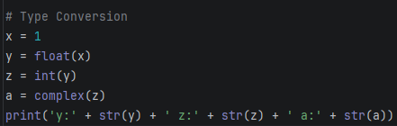
Type Conversion - Casting
If you convert a float to an int, data loss can occur
You cannot convert complex numbers into another datatype

Slide 25
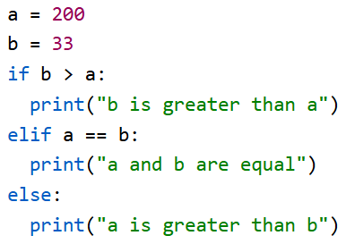
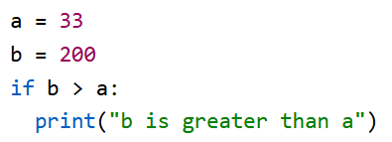
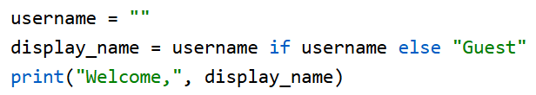
Control Flow

Slide 26
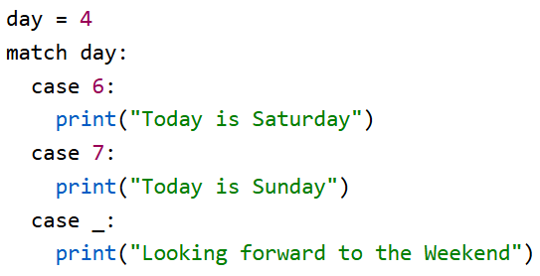
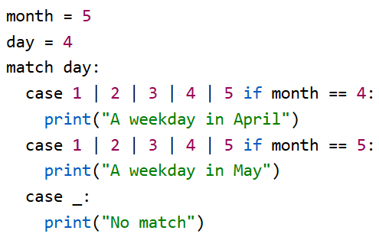
Match
‘_’ will always match, so place it at the end!
We can match multiple conditions at once
We can optionally include an if condition as an extra condition check

Slide 27
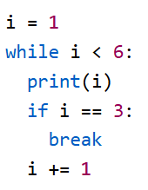
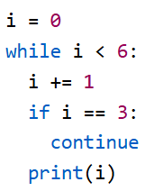
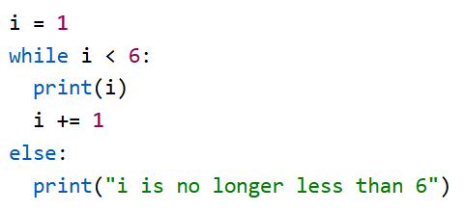
While Loops
What is the output of the following:

Slide 28
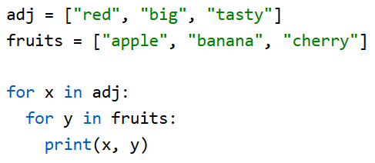
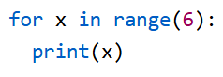
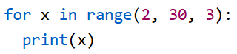
For Loops
We can use for loops to iterate over lists, tuples, dictionaries, sets, or strings
For loops may be nested
Break/Continue is available
We can use range() to iterate a certain number of times, or by a sequence

Slide 29
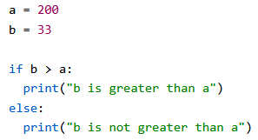
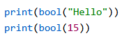
Boolean Behavior & If Statements
Logical evaluations will return a boolean
If statements use evaluations to route logic
The bool() constructor will make an evaluation of whatever is passed to it (The example returns ‘true’ for both)

Slide 30
Boolean Falsy Values
print(bool(False)) # bool
print(bool(None)) # NoneType
print(bool(0)) # int
print(bool("")) # str
print(bool(())) # tuple
print(bool([])) # list
print(bool({})) # dict

Slide 31
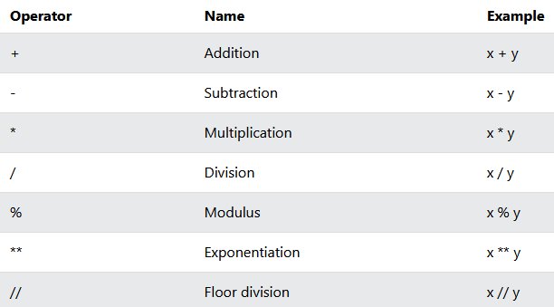
Arithmetic Operators
/ = returns float
// = returns integer

Slide 32
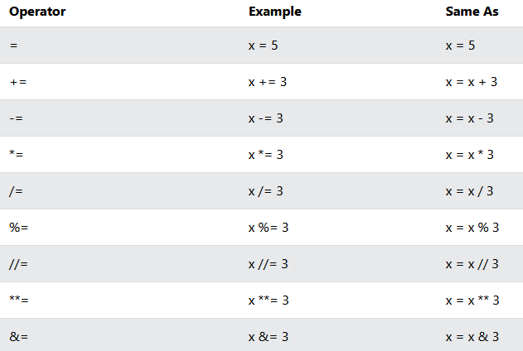
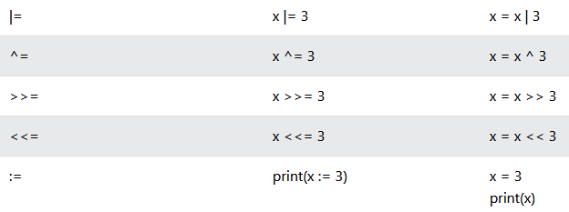
Assignment Operators
“:=” = python 3 walrus operator. It can accept an evaluation!

Slide 33
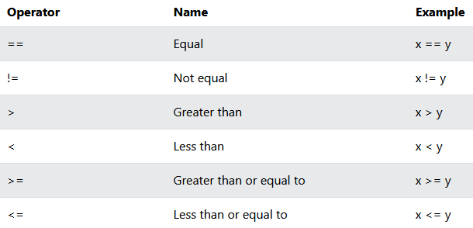
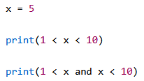
Comparison Operator
We may chain them!

Slide 34
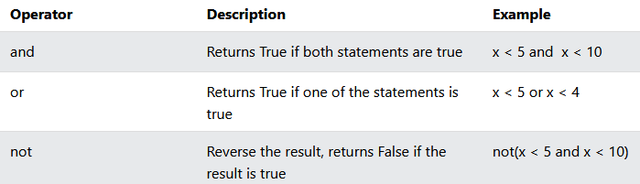
Logical Operators

Slide 35
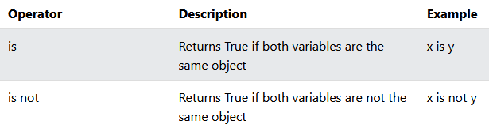
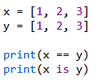
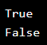
Identity Operators

Slide 36
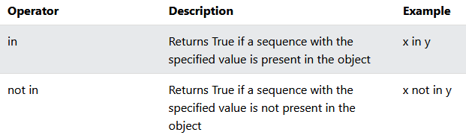
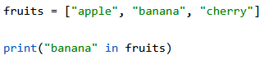
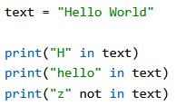
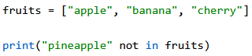
Membership Operators

Slide 37
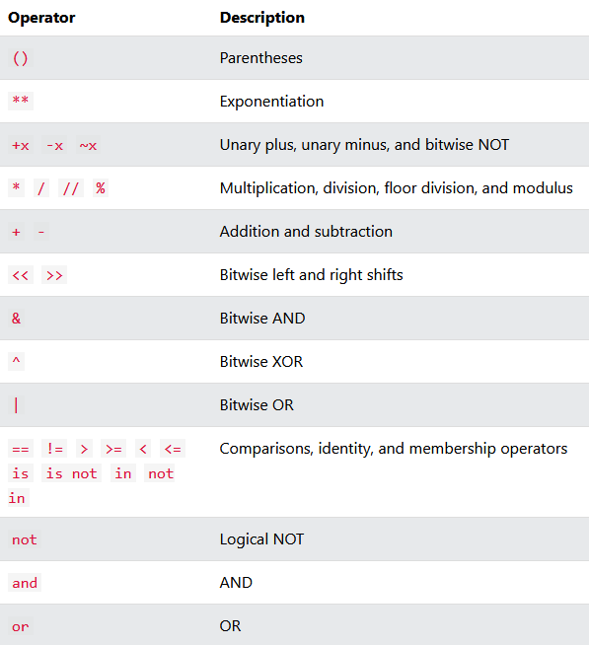
Operator Precedence
Remember PEMDAS?

Slide 38
Challenge
Goal:
PyCharm challenges
Details: ~45-60 min
Complete the following in the 100 Days of Code PyCharm course:
Day 1 (All tasks)
Day 2 (All tasks)
Day 3 (All tasks)

Slide 39



Quoteception, escape characters, & Multi-Line Strings

Slide 40


Check the contents of a string

Slide 41



Slicing Strings
Slice from the start: ‘Hello’
Or from the end: ‘llo, World!’
‘llo’
2 inclusive
5 exclusive

Slide 42





Other String Methods
Force upper/lower case text
Remove whitespace at the beginning/end of strings
Replace every piece of matching text content with another string
Return a list of split strings

Slide 43




F-Strings
Formatted String literals were introduced in Python 3
Dynamically assign values in strings
Perform evaluations & format data

Slide 44

R-Strings
Raw strings will force the string to behave literally:

Slide 45



String Method Reference
https://www.w3schools.com/python/python_strings_methods.asp

Slide 46
Challenge
Goal:
Format a string value
Details: ~25 min
Given the username:
‘raw_username = " Py_Thon-ROCKS123!!! "
Do the following:
Remove whitespace
Convert to all lowercase
Replace all ‘-’ with ‘_’
Remove all ‘!’
Check at least once digit is present
Check it contains the word ‘python’
Create a variable that stores only the first 8 characters
Print a formatted string (f-string) that displays: the cleaned username, whether it contains a digit, whether it contains ‘python’, & the first 8 characters

Slide 47
Collections
Lists
Ordered/indexed
Changeable
Allows duplicates
Tuples
Ordered
Unchangeable
Allows duplicates
Sets
Unordered
Unchangeable
Unindexed
Dictionaries
Ordered
Changeable
No duplicates

Slide 48


Immutable vs Mutable Types
Non-collection types are also called immutable, because a new space is reserved in memory for each new declaration.
Collections are mutable because we may add and remove to the existing object in memory.

Slide 49




Lists
We can easily get the length of a list
Lists can be ANY datatype
Lists can contain mixed datatypes
Retrieve items from positive/negative indices

Slide 50

More List Syntax
Get a range of items
Get a range of items from the beginning to a defined stop point
Get a range of items from a defined start point till the end
Check if items are in a list

Slide 51






Modifying Lists
Replace items in a list from its index
Insert multiple new items into a list while replacing items
Insert items without replacing anything
Add items to the end of a list
Concatenate a list and another list/set/dictionary

Slide 52




Modifying Lists
Remove a specific object by its identity
Remove a specific item by its index with pop(), or just the last item if nothing specified
The del keyword can delete an item or the list itself
The clear() method empties the list but the list still exists in memory

Slide 53




Iterating over lists
For loops can iterate over lists
While loops can iterate over lists
List Comprehension syntax is the shortest form to iterate over a list

Slide 54


List Comprehension
Create a new list of fruits that have ‘a’ in the name.
List comprehension is syntactic sugar that shortens/cleans up our code!

Slide 55
List Comprehension
List Comprehension will return a new list, leaving the old one unchanged.
The expression is the current item in the iteration but also the outcome. We can modify the item before it stores in the new list:
Return the item if it is NOT banana, if it IS banana then return orange.

Slide 56



Sort Lists
Sort Alphabetically/Numerically:
Sort descending:

Slide 57


Case Insensitive Sort
This gives unexpected results (sorts uppercase words first)
Set all values to lowercase before your sort, thus making it case-insensitive (won’t permanently change the values):

Slide 58


Custom Sort
Define a function to use as a sorting algorithm
The first example will sort the list from least>most words
We can have more than one key; The second example uses this to reverse the list

Slide 59



Lambdas
Instead of creating a custom sort function, we could also use a lambda!

Slide 60

Challenge
Goal:
Work with Lambdas
Details: ~10 min
Given the students list of tuples, do the following:
Sort the list so that it goes from oldest>youngest

Slide 61

Reversing a list

Slide 62
Other list methods
List Method Reference

Slide 63


Modules & Docstrings
my_module.py:
This can be another .py file or from a notebook:

Slide 64


Random Numbers

Slide 65
Challenge
Goal:
Complete PyCharm challenges
Details: ~20 min
Complete Day 4 (All Activities)
(Day 7 + 8 Recommended)

Slide 66
Tuples
Remember Tuples are:
Ordered, allows duplicates, & unchangeable
Can be any type & tuples can have mixed types
Access syntax is identical to lists

Slide 67

Tuples
We can’t change a tuple, but we can:
Convert the tuple to a list
Make a change, delete, or add items
Convert the list back into a tuple

Slide 68

Unpacking Tuples

Slide 69


Count unique items & get the index of an item

Slide 70

Challenge
Goal:
Manipulate Tuples
Details: ~15 min
Given the following list of tuples, complete the following using only List Comprehension:
Print only students with an ‘A’
Print all names (but nothing else)
Give all the 20-year old students a ‘B’ and then print the list
Also the output

Slide 71
Sets
Sets are: unordered, unindexed, & items are unchangeable.
Any type and mixed types are allowed, but duplicated are not (1=True, 0=False considered duplicates):

Slide 72



Set Access
Either loop through it or use membership operators:

Slide 73





Add/Remove Set Items
We can’t modify set items but we can add/remove them:
**remove method has warnings, discard does not. **pop will remove random item

Slide 74
More on Sets
Join Sets
Frozen Sets
Set Method Reference

Slide 75

Challenge
Goal:
Manipulate Sets
Details: ~15 min
Given the following list, complete the following:
Create a set from the list to remove duplicates
Print the total number of attendees
Print ‘Alice is going!’ if Alice is found in the set
Add ‘Grace’ to the set
Remove ‘Bob’ from the set twice (don’t throw errors)
Print the final complete set of attendees

Slide 76

Dictionaries
Dictionaries are key/value pairs
Ordered, changeable, no duplicates
Python 3.6 and earlier - dictionaries are unordered
Access items with ‘[]’ syntax or thisdict.get(‘key’) method

Slide 77






Dictionaries

Slide 78





Dictionaries
Removes the last item, i.e. ‘year’:1964

Slide 79


Looping Dictionaries

Slide 80
Challenge
Goal:
Complete PyCharm challenges
Details: ~25 min
Complete Day 9 (All tasks)

Slide 81
What is Procedural Programming? What is OOP?

Slide 82


Slide 83


Classes
The ‘self’ parameter must be included as the first parameter in any class method
Self has access to other class methods/variables
We can delete instantiations of a class
We can use the pass keyword as a placeholder

Slide 84

__init__ - totally not a constructor
Under the hood, a ‘__new__’ method gets called to create the object
‘__init__’ runs after, and initializes object state

Slide 85




Objects are very flexible in Python
Dot notation access: Change values: Delete values: Add new values:

Slide 86


__str__
The __str__ method controls what is returned when the object is printed

Slide 87



Inheritance
Inherit all the methods and properties from another class
Parent/Base Class
Child/Derived Class
This code is incomplete:

Slide 88




Inheritance
We need to add an __init__ in our child class so it doesn’t generally inherit the parent class __init__
We should use super() instead of calling the parent directly, so as not to break multiple-inheritance

Slide 89

Function Polymorphism
Polymorphism refers to functions/classes behaving differently depending on input or object type
Another example of function polymorphism is len()

Slide 90


Class Polymorphism

Slide 91




Encapsulation
Private method:
Single “_” denotes a protected property. This is only a convention.

Slide 92



Abstraction

Slide 93


Abstract Properties

Slide 94

Or just use a Protocol
Protocols are often the preferred way to abstract a class
No forced inheritance
Static type checking (mypy, pyright)
Flexible & easy setup

Slide 95

@staticmethod

Slide 96


@classmethod
Takes the class itself implicitly as ‘cls’
Belongs to the class, not the instance
Can access class variables and other class methods but NOT instance variables

Slide 97

SOLID app structure
Notebooks and unit tests should live separately from source code
Tests should mirror src layout
Each package should have its own ‘__init__.py’ file
pyproject.toml & poetry.lock will be autogenerated from our poetry commands

Slide 98
Manage Interpreters with pyenv-win
https://github.com/pyenv-win/pyenv-win
Install: Invoke-WebRequest -UseBasicParsing -Uri "https://raw.githubusercontent.com/pyenv-win/pyenv-win/master/pyenv-win/install-pyenv-win.ps1" -OutFile "./install-pyenv-win.ps1"; &"./install-pyenv-win.ps1
Run pyenv --version to check if the installation was successful.
Run pyenv install -l to check a list of Python versions supported by pyenv-win
Run pyenv install <version> to install the supported version
Run pyenv global <version> to set a Python version as the global version

Slide 99
Poetry
Use the official installer (curl)
Set virtual environments to install in project folder
Install deps and dev deps
install/lock
Run your app

Slide 100
Pause Here
(We build a REPL app with SOLID principles)
Code-along suggested; too much for slides

Slide 101
Numpy
Numpy runs C/C++ under the hood and provides an array object that is up to 50 times faster than Python lists.
These are called ndarrays (n-dimension arrays).
Fixed datatype
Arbitrary dimensions
vectorized
For comparison, Lists:
Can hold mixed types
Don’t scale to multiple dimensions naturally
Aren’t vectorized

Slide 102






Arrays of multiple dimensions
<- check the shape ex:(2, 4)
<- check number of dimensions

Slide 103



Data Access
Get an item just like lists:
Just kidding, here’s a 2-d array:
3-d array access:

Slide 104



Slice & Steps
Slice an array:
Return every other element from index 1-5
Note: [inclusive start, exclusive end)
Return every other element in entire array:

Slide 105




Numpy data types

Slide 106


COPY vs VIEW
COPY receives a 1 for 1 copy. VIEW creates a pointer to same data buffer (not the same as memory address).
Note: arrays can be expensive in ML/Data Science. It’s often times easier and more performant to create different!

Slide 107

Reshape
[[ 0 1 2]
[ 3 4 5]
[ 6 7 8]
[ 9 10 11]]
[ 0 1 2 3 4 5 6 7 8 9 10 11]
—>

Slide 108



Iteration

Slide 109





Joins

Slide 110


Split

Slide 111



Search
Binary searches on sorted arrays ->

Slide 112


Sort
Sort will return a copy of the array!

Slide 113

Filters/Boolean Masks

Slide 114



Random & ufuncs
There are many random methods:
Without & with universal functions:

Slide 115

Format Numeric Output

Slide 116


The power of numpy!
Pandas can replace the functionality of these (but tradeoffs exist):

Slide 117
Pandas
Pandas is a Python library used for working with data sets.
Pandas = “Panel Data” + “Python Data Analysis”
Find correlations between two or more columns
Find average values
Min/Max
Delete rows of bad or empty data. I.e. ‘data cleaning’

Slide 118

Pandas
Each series is like a column in a table ->

Slide 119


Labels

Slide 120

DataFrames
If a series is a column, then a DataFrame is the whole table:

Slide 121


Selecting Rows
Note that a Pandas series or a DataFrame may be returned:

Slide 122


Naming Indexes

Slide 123


Read Data from Files (CSV)
If we have a large dataset, Pandas will only return the first 5 and last 5 records. Use to_string() to print the entire DataFrame
<- Pandas has built-in settings that alter its behavior. This will set the max rows a DataFrame must have, before it will cut off records in print statements.

Slide 124

Read Data from JSON
JSON works similarly to CSV files
Sidenote: dictionaries can be loaded into Pandas directly

Slide 125

Heads or Tails?

Slide 126


Info & Describe
The calories column has null rows!

Slide 127




Cleaning Empty Cells
These methods only work if the field is NaN, None, or pd.na! I.e. empty strings skipped
Get a copy with no nulls:
Replace nulls with a value:
Alter original:
Replace only for a certain column:
Note: mean() or median() would also work here.

Slide 128



Cleaning Wrong Format
01282026
01/28/2026
01-28-26

Slide 129


Fixing Wrong Data
Set a specific item:
Loop through the DataFrame and conditionally change value:
Loop through and drop rows that don’t meet the conditions:

Slide 130


Removing Duplicates
Get booleans for any item that is a duplicate:
Drop any duplicates:

Slide 131



Data Correlations
1 = perfect correlation (1-1 movement)
-1 = perfect negative correlation (inverse movement)
0 = No correlation at all
corr() can only work with numeric types
Can also do this:

Slide 132

Filter/Sort Records

Slide 133
Challenge
Goal:
Clean data with Pandas
Details: ? min
Use the provided JSON dataset and complete the following:
Some string values may be, “” instead of null. Set these fields to NaN with numpy before you continue cleaning
Clamp publication year to the years of 1800-2026
Ensure average_rating, page_count, etc can’t have impossible values
Normalize dates in ‘last_checkout’
Ensure genres, languages, formats, and publishers have proper capitalization
Find and remove duplicate books with the same title/author
Drop rows with empty fields

Slide 134


Group By

Slide 135

agg()
Remember:
groupby() -> labels
agg() -> series/columns

Slide 136


Matplotlib
Matplotlib is a low level graph plotting library
Visualization utility
Open source
Written in python, c, Objective-C, and JavaScript

Slide 137




O vs marker=’o’
Marker Reference

Slide 138



Plotting Multiple Points
Both x, y:
Only y:
(x will increment automatically to meet y)

Slide 139


fmt, colors, lines
fmt = marker | line | color
ms = marker size
mec = marker edge color
mgc = marker face color
Line & Color Reference

Slide 140

Arguments
We’ve seen the shorthand, but many of the options have explicit arguments, such as linestyle/ls
color/c
linewidth/lw

Slide 141



Multiple Lines

Slide 142


Styling your Plot

Slide 143


Subplots
subplot(rows, columns, plot #)
We can add as many as we wish, just specify those three things
Aside from hspace, there is also, left, right, top, bottom, and wspace

Slide 144


Scatter Plots
Colormap Reference

Slide 145



Bar Graphs

Slide 146


Histograms

Slide 147



Pie Charts
The first wedge starts at 0 degrees and then wedges are laid counterclockwise.
Wedge size = x/sum(x)

Slide 148
Docker
Docker lets us package apps + its OS level environment into a reproducible box.
Those boxes are called images.
When you run an image you get a container.
A Dockerfile is a recipe for building images.

Slide 149


Consider your version
Docker Hub:
Python doesn’t do “LTS” releases.

Slide 150
Packages
Pyproject.toml new dependencies:
Sqlalchemy - maps python objects to database tables
Psycopg[binary] - driver to communicate with postressql
Sqlalchemy-utils - misc utilities
Alembic - managed db schema migrations
Python-dotenv - work with env variables
Fastapi - routes HTTP request to python code
Uvicorn - runs your web app and handles network traffic
Pydantic - provides serialization, DTO-like functionality
Run ‘poetry run alembic init alembic’ to generate folders/files for migrations

Slide 151
Single vs Multi-Stage Dockerfiles
Ships Everything: Only ships what’s needed:
FROM node:20
WORKDIR /app
COPY . .
RUN npm install && npm run build
CMD ["npm", "start"]
FROM node:20 AS builder
WORKDIR /app
COPY . .
RUN npm install && npm run build
FROM node:20-slim
WORKDIR /app
COPY --from=builder /app/dist ./dist
COPY --from=builder /app/node_modules ./node_modules
CMD ["node", "dist/index.js"]

Slide 152
Multi-Stage Image - Python App
FROM python:3.12-slim AS builder
WORKDIR /app
RUN apt-get update && apt-get install -y curl build-essential
RUN curl -sSL https://install.python-poetry.org | python3 -
ENV PATH="/root/.local/bin:$PATH"
COPY pyproject.toml poetry.lock /app/
RUN poetry config virtualenvs.create false
RUN poetry install --without dev --no-interaction --no-ansi
ENV PATH="/usr/local/bin:/root/.local/bin:$PATH"
COPY src /app/src
COPY src/repl.py /app/repl.py
COPY alembic.ini /app/alembic.ini
COPY alembic /app/alembic
Stage 1: builder
- Install system deps
- Install Poetry
- Set PATH to Poetry
- Turn off venv generation
- Install Python dependencies
- Add Alembic/uvicorn to PATH
- Copy source code/migrations

Slide 153
Multi-Stage Image - Python App
Stage 2: runtime
- We start with clean Python image - no curl, no build tools, no poetry install script, much smaller
- Copy only built artifacts
- Python Packages
- Source Code
- Poetry Binary
- Run the app
FROM python:3.12-slim
WORKDIR /app
COPY --from=builder /usr/local/lib/python3.12 /usr/local/lib/python3.12
COPY --from=builder /app /app
COPY --from=builder /usr/local/bin /usr/local/bin
ENV PYTHONUNBUFFERED=1
ENV PATH=”/usr/local/bin:/root/.local/bin:$PATH”
CMD ["uvicorn", "src.main:app", "--host", "0.0.0.0", "--port", "8000"]

Slide 154
Docker Compose
Docker Compose is a tool to define and run multi-container applications.
Spin up multiple containers at once
Define dependencies between services
Share environment variables
Manage volumes (persist data between restarts)

Slide 155
Super Ugly Docker Compose Slide :) sorry
services:
app:
build: .
container_name: myapp
env_file:
- .env
#volumes:
# - .:/app
depends_on:
db:
condition: service_healthy
ports:
- "8000:8000"
command: ["uvicorn", "src.main:app", "--host", "0.0.0.0", "--port", "8000"]
db:
image: postgres:15
container_name: mydb
env_file:
- .env
environment:
POSTGRES_USER: ${POSTGRES_USER}
POSTGRES_PASSWORD: ${POSTGRES_PASSWORD}
POSTGRES_DB: ${POSTGRES_DB}
ports:
- "5432:5432"
volumes:
- postgres_data:/var/lib/postgresql/data
healthcheck:
test: ["CMD-SHELL", "pg_isready -U ${POSTGRES_USER} -d ${POSTGRES_DB}"]
interval: 5s
timeout: 5s
retries: 5
volumes:
postgres_data:

Slide 156
First Migration / Build

Slide 157
Other Helpful Commands
alembic upgrade <revision> = Applies migrations up to the specified revision. head applies all pending migrations.
alembic downgrade <revision>
Rolls back migrations. Examples:
alembic downgrade -1 → step back 1 revision
alembic downgrade base → go back to the initial state
alembic history = Shows the list of all migrations and their revision IDs.
alembic current = Displays the current revision(s) applied to the database.
alembic heads = Shows the latest revision(s) in the migration tree (useful if you have multiple heads/branches).
alembic branches = Lists any branching points in your migration history.

